Slide 1
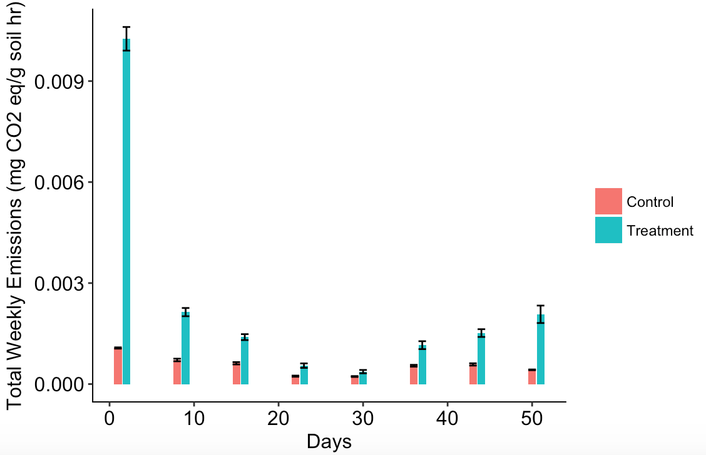
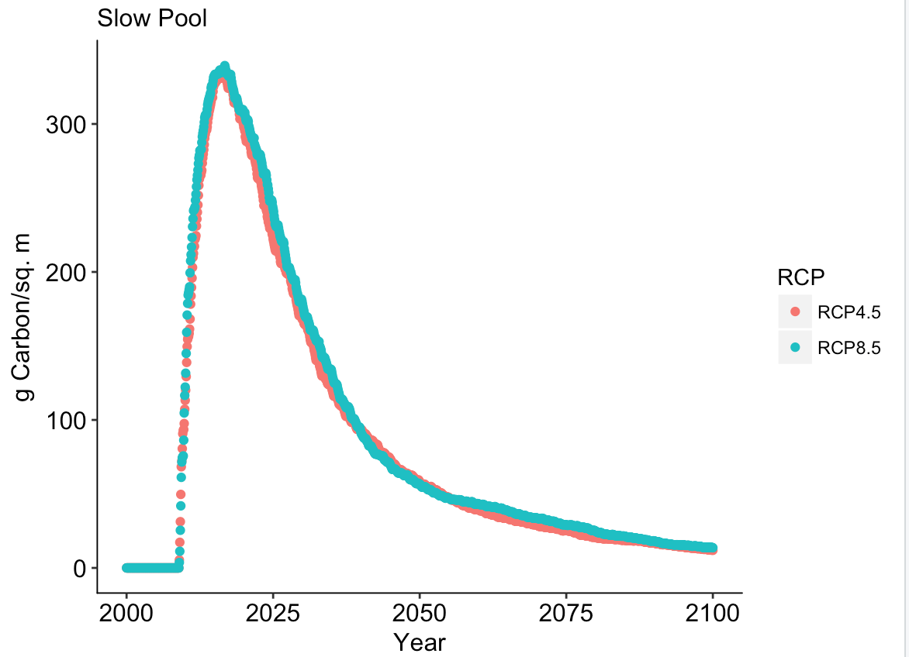
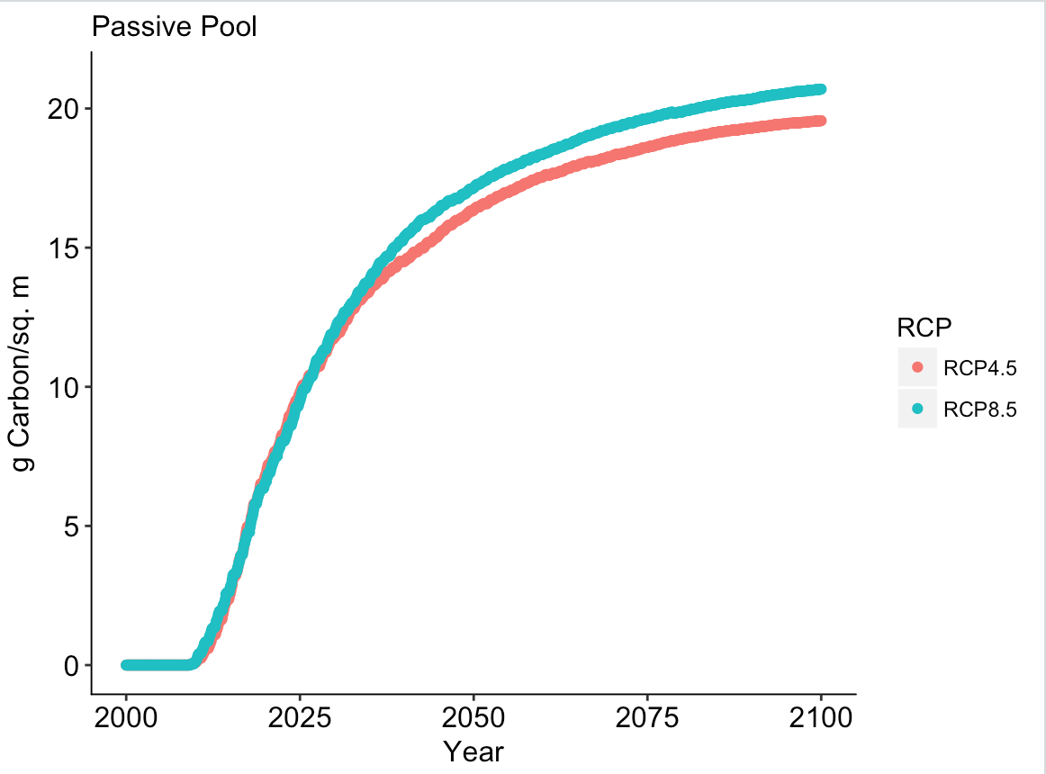
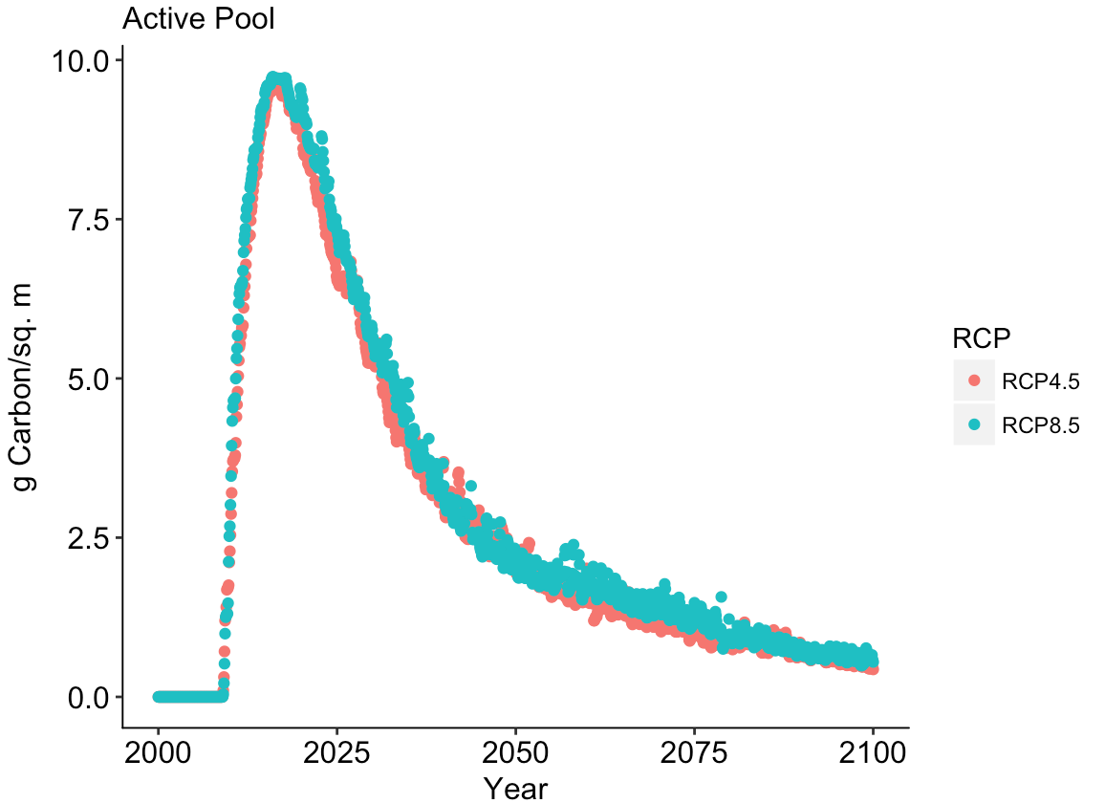
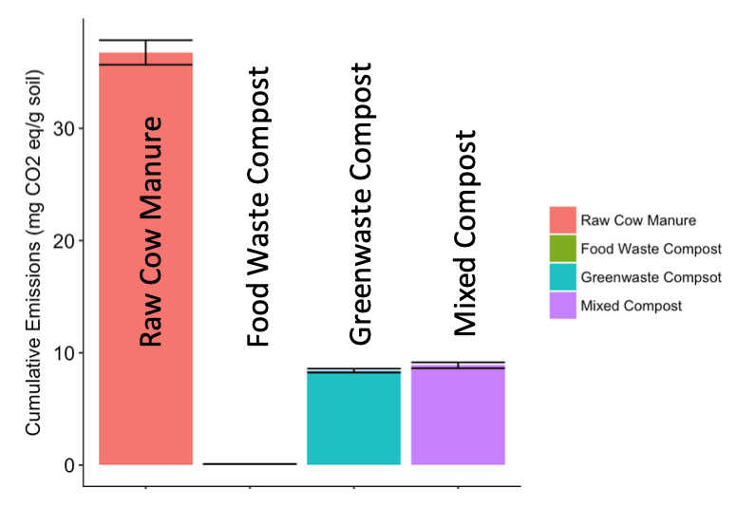
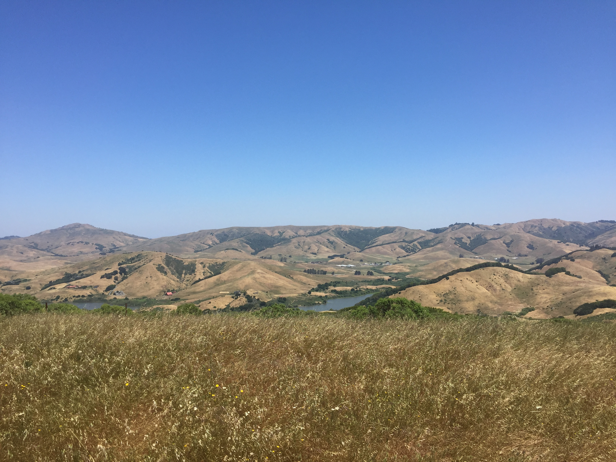
Climate Change Mitigation Potential of Food Waste Compost Application to Grassland Soils Hannah Marsh, Allegra Mayer & Whendee L. Silver Department of Environmental Science, Policy and Management University of California Carbon Neutrality Initiative Fellowship hmmarsh@Berkeley.edu
Introduction
Methods
Compost application to grassland soils has potential to reduce atmospheric carbon dioxide (CO₂) because it has been shown to have a lasting positive effect on soil carbon storage and plant productivity (Ryals et al 2014). The added organic matter the soil receives from compost stimulates growth of vegetation, which increases carbon capture by photosynthesis (Ryals et al. 2015).
Recent studies have primarily tested the effects of manure and plant waste compost (Ryals et al 2015), but we could find no published research that has tested the net flux of greenhouse gas emissions from food waste compost when applied to grassland soils. As more cities across the United States begin to compost and pledge to the zero-waste movement, food waste is becoming an available and affordable resource
To determine the impact of compost amendments on greenhouse gas emissions, we directly measured the CO₂, CH₄, and N₂O emissions from soil applied with food waste versus a control scenario that had received no food waste application. We repeated the gas sampling once weekly for seven weeks.
In this experiment we used, the biogeochemical model, DayCent to simulate the effect of one application of food waste compost to rangeland soil on the net flux of carbon and nitrogen over time. The model was run under a high emissions scenario (RCP 8.5) and a emissions reduction climate warming scenario (RCP 4.5).
Results: Compost addition increased aerobic soil respiration but did not increase CH4 or N2O emissions.
Project Goals
Only CO₂ fluxes were significantly higher in the treatment than the control scenario. (P < 0.0001). Soil CO₂ fluxes contributed 99% of the total cumulative emissions over the 7 week incubation.
This study aimed to understand:
the effects of food waste compost application on the net flux of CO₂ equivalents (CO₂e) between the atmosphere and soil carbon stocks.
to compare the results of food waste compost with other available compost compositions in order to explore the range of CO₂e fluxes that compost can induce.
Modeled soil carbon increases for decades after one-time food waste compost addition.
Study Site
Food waste compost has much lower GHG emissions when applied grasslands in comparison to other tested composts.
We conducted the incubation study using soils from the Nicasio Native Grass Ranch in Nicasio, CA (38.0834°N, 122.7633°W); all lab work was conducted at the University of California, Berkeley, CA. The landscape contains both native perennial grass species (Stipa pulcra, Danthonia californica) and non-native annual grasses (Avena barbata, Festuca perennis) (Ryals and Silver 2013).
Food waste compost application is distinct from all other tested soil amendments due to much lower emissions, suggesting a greater potential to mitigate climate change.
Conclusions
No significant contribution of harmful N₂O and CH₄ emissions between the control and the treatment scenarios.
The modeling results show a long-term increase in soil carbon following the application of food waste compost.
Of all the composts tested, food waste compost showed the greatest potential to minimize greenhouse gas emissions.
Literature Cited
Acknowledgements
Ryals, R., M. D. Hartman, W. J. Parton, M. S. Delonge, and W. L. Silver. 2015. Long-term climate change mitigation potential with organic matter management on grasslands. Ecological Applications 25:531-545.
Ryals R, Kaiser M, Torn MS, Berhe AA, Silver WL. 2014. Impacts of organic matter amendments on carbon and nitrogen dynamics in grassland soils. Soil Biology and Biochemistry, 68, 52–61.
Ryals, R., and W. L. Silver. 2013. Effects of organic matter amendments on net primary productivity and greenhouse gas emissions in annual grassland ecosystems. Ecological Applications 23: 46–59.
Thank you so much to everyone at the Silver Lab for all of the technical support and guidance. Thank you especially to Allegra Mayer and Whendee Silver for mentoring me during the whole of this project. Also, a major thanks you to the teaching teams behind ESPM 175 and ESPM 100es. Tina Mendez, Leslie McGinnis, John Battles, and Jacob Bukoski. your feedback was greatly appreciated.
Notes:
Phase II: In-depth assessment (similar to LEEDS) and information exchange with entire research group. Inform staff of support services, shared equipment, onservation impact, altered techniques or materials. Inquire: needs and concerns
Phase III: Follow up

